Slide 1
TORP Project
YOUR NAME
COMPANY
PROJECTS
DD/MM/20XX
Design and Analysis Overview

Slide 2
Introduction
Conductive hearing loss occurs when sound is not effectively transmitted in the middle ear. Total Ossicular Replacement Prostheses (TORPs) restore hearing by replacing damaged ossicles. Essential TORP requirements include biocompatibility, mechanical stability, and absence of resonance to ensure reliable performance.

Slide 3
Conductive Hearing Loss & TORPs
01

Slide 4
Understanding conductive hearing loss
Sound vibrations fail to effectively reach the inner ear due to ossicular chain damage, resulting in hearing impairment. TORPs restore the mechanical linkage between the eardrum and cochlea, improving auditory function.

Slide 5
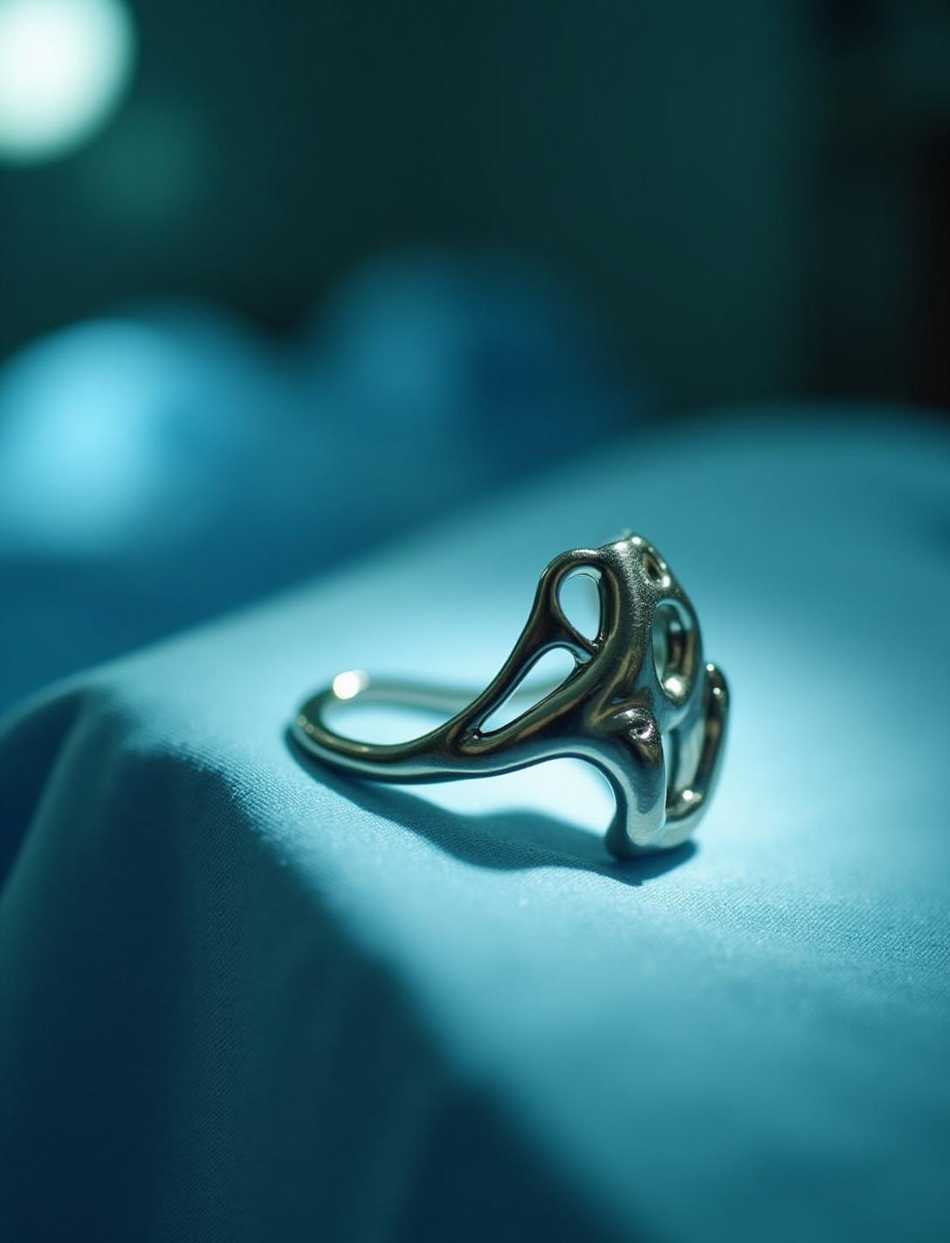
Importance of TORPs in treatment
TORPs replace the entire ossicular chain, reestablishing sound transmission in patients with severe conductive hearing loss. Proper design avoids tissue damage and ensures long-term implant success.

Slide 6
Essential design requirements for TORPs
Materials must be biocompatible to avoid rejection. Prostheses must be mechanically stable under physiological loads and avoid resonance within the human hearing range (100–6000 Hz) to prevent sound distortion.

Slide 7
Design and Analysis of TORPs
02

Slide 8
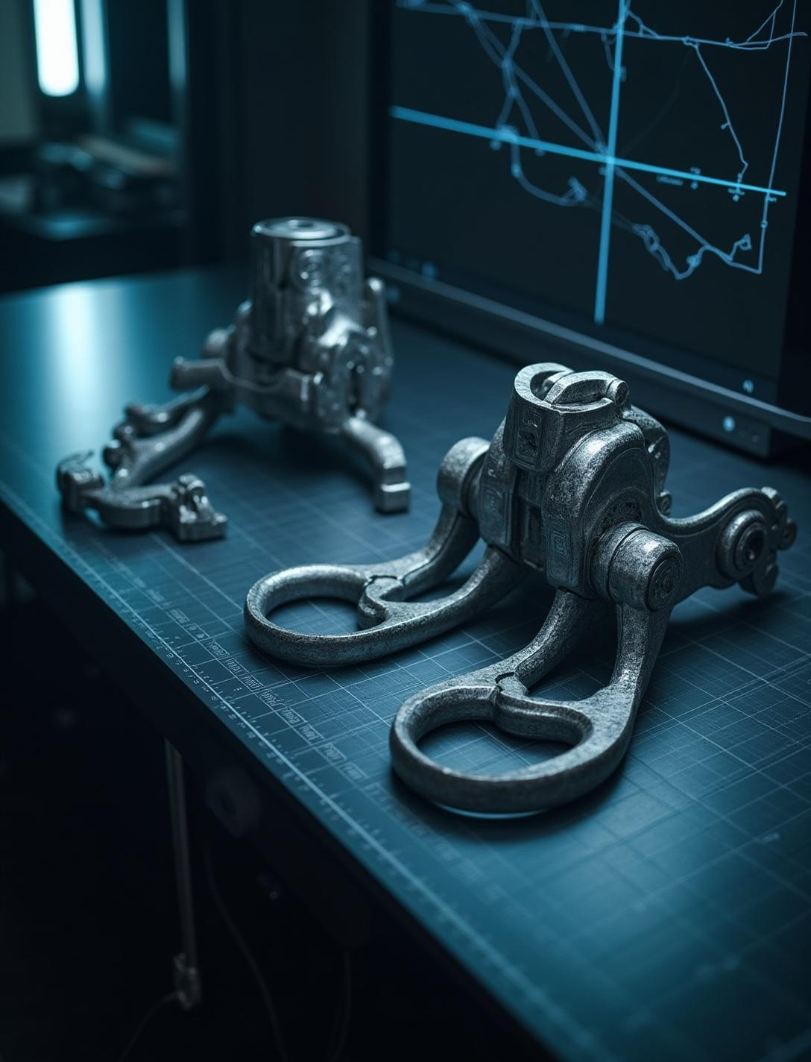
CAD modeling and key design features
The TORP model was developed in Autodesk Fusion 360 featuring a footplate, shaft, and head with precise dimensions designed for anatomical fit, manufacturability, and mechanical robustness.

Slide 9
Material selection and properties
Ti-6Al-4V titanium alloy was selected due to its high strength-to-weight ratio, excellent corrosion resistance, and proven biocompatibility for long-term implantation.

Slide 10
Simulation methodologies and analysis results
Static stress analysis revealed maximum displacement in the nanometer range and stress far below the titanium yield strength, with a safety factor of 15. Modal analysis showed natural frequencies from 7.4 kHz to 188 kHz, all above the hearing range, ensuring dynamic stability without resonance.

Slide 11
Essential design requirements for TORPs
TORPs must be biocompatible, mechanically stable, and free from resonance effects within the hearing frequency range to ensure reliable auditory performance and long-term implant success.

Slide 12
Design and Analysis of TORPs
03

Slide 13
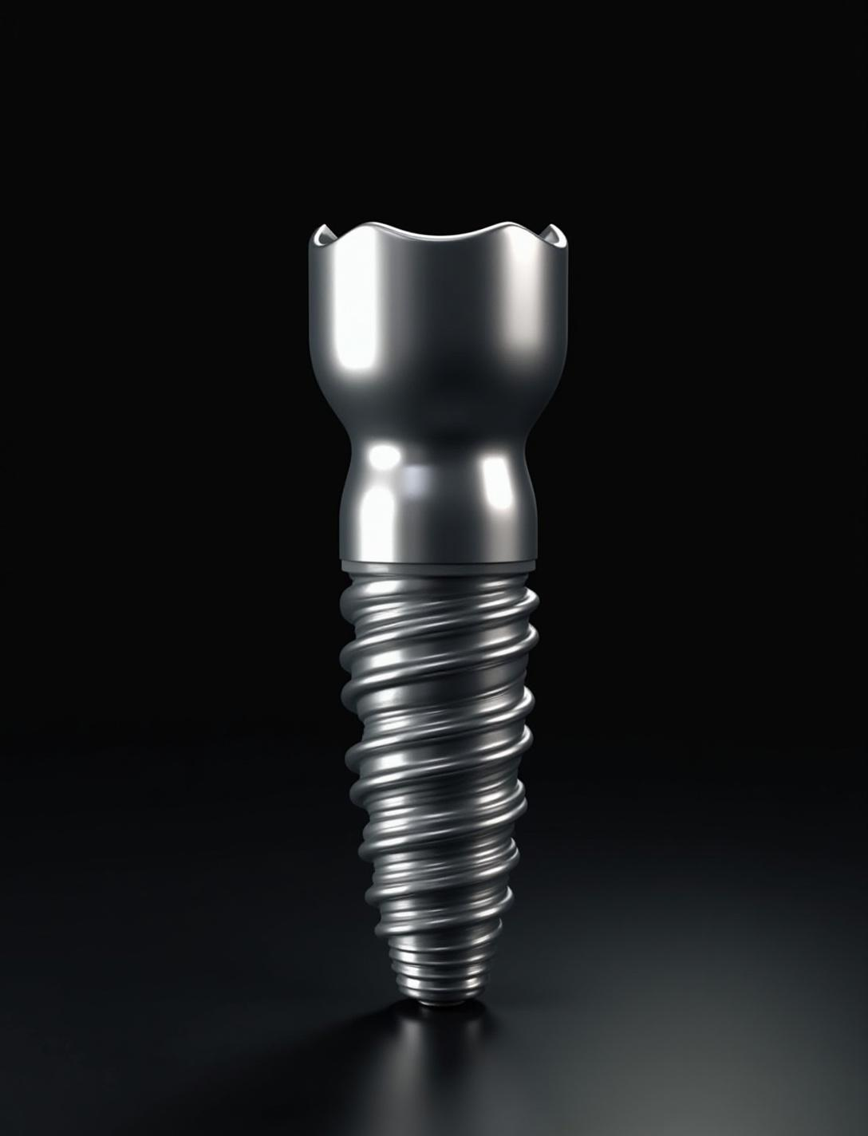
CAD modeling and key design features
Designed in Fusion 360, the TORP includes a footplate, shaft, and head with precise dimensions optimized for light weight, smooth surface, and manufacturability.

Slide 14
Material selection and properties
The Ti-6Al-4V titanium alloy was chosen for its high strength-to-weight ratio, corrosion resistance, and excellent biocompatibility, making it ideal for implant applications.

Slide 15
Simulation methodologies and analysis results
Static and modal analyses showed negligible displacement, stresses well below yield strength, and natural frequencies (7.4 kHz–188 kHz) above the hearing range, confirming design safety and avoiding resonance.

Slide 16
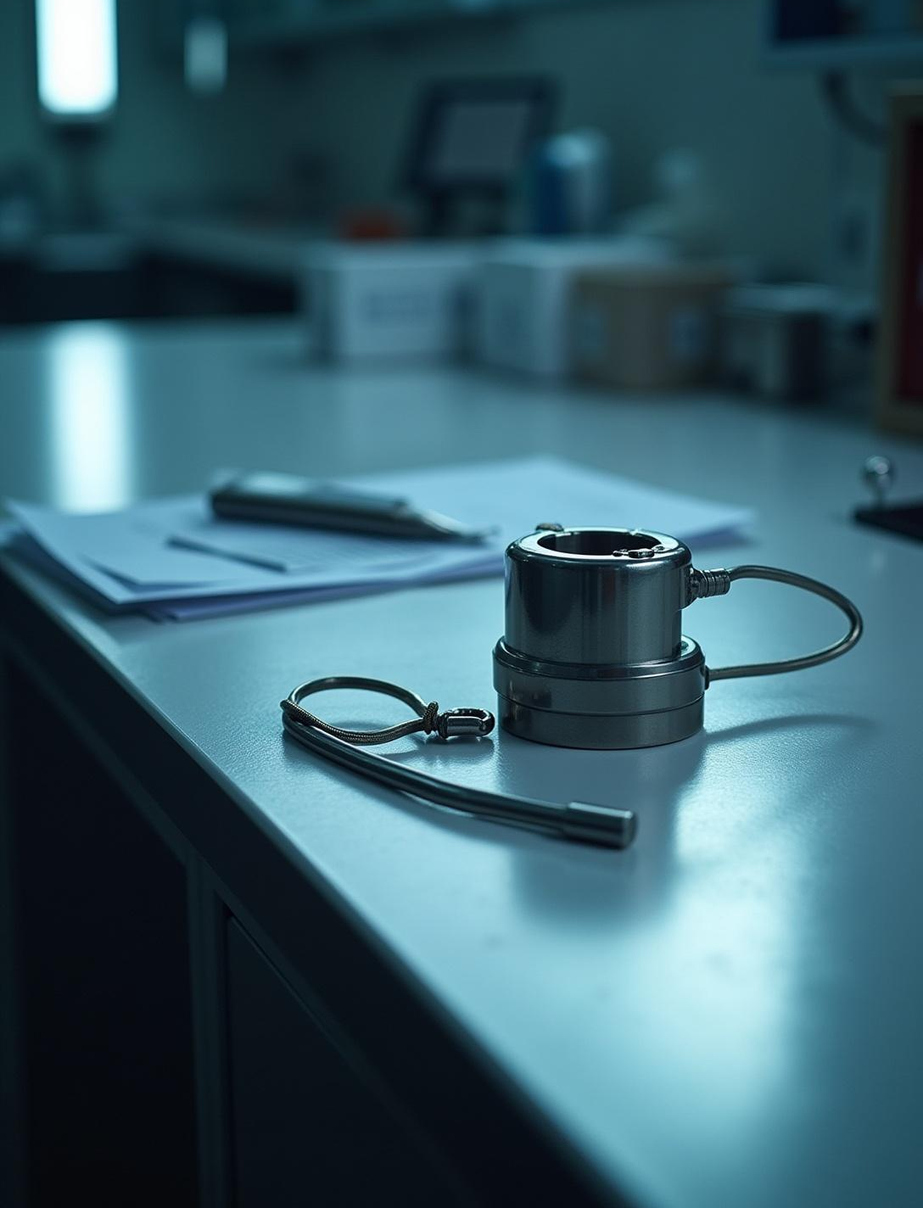
Conclusions
The TORP design is safe, reliable, and suitable for further development. It provides a strong foundation for prototyping, validation, and future clinical applications.

Slide 17
Thank you!
+00 000 000 000
Do you have any questions?

